Slide 1
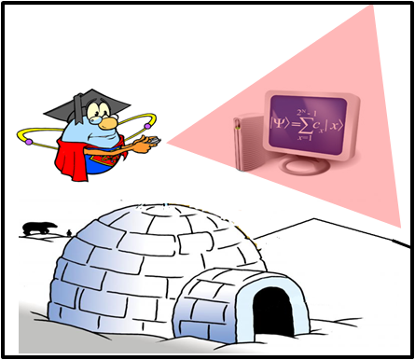

The Super-cool atom computer
Ana Maria Rey
Saturday Physics Series, Nov 14/ 2009

Slide 2
Outline
What are ultra-cold atoms?
What is quantum information?
What do we need to build a quantum computer?
Quantum information with ultra-cold atoms
Outlook

Slide 3
What is an atom?
The atom is a basic unit of matter
The smallest unit of an element, having all the characteristics of that element
Matter
-
n
e
+
p
Atoms
Electrons, neutrons y protons

Slide 4
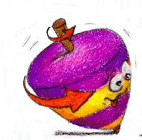
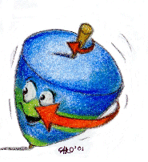
Particles have spin
Particles have an intrinsic angular momentum (spin)
Electrons, protons, neutrons have spin 1/2
S=1/2
Or ↑
S=-1/2
Or ↓
The total spin of an atom depends on the number of electrons, protons and neutrons

Slide 5

There are two types of particles
Bosons
Fermions
Named after S. Bose
Named after E. Fermi
Integral spin. Want to be in the same state.
Half-integral spin . No two fermions may occupy the same quantum state simultaneously.
Example: ⁴He since it is made of 2 protons, 2 neutrons, 2 electrons
Example: Protons, electrons, neutrons....

Slide 6
Ultra-cold atoms
The temperature of a gas is a measure related to the average kinetic energy of its atoms
Hot
Fast
Cold
Slow
Room temperature
~ 300 m/s
300
27
Water freezes
250
-23
In 1995 thousands of atoms were cooled to 0.000000001 K
Dry ice
200
-73
150
-123
Celsius
Kelvin
100
-173
N₂ condensation 77 K
~ 150 m/s
50
-223
He condensation 4K
~ 90 m/s
0
-273
Velocity of only few cm/s
Absolute Zero

Slide 7
What does it happen at low T?
Wave-particle duality: All matter exhibits both wave-like and particle-like properties. De Broglie, Nobel prize 1929
High temperature
“billard balls”
Classical physics
Low temperature:
“Wave packets”
Quantum physics begins to rule
T=T_{c} Bose–Einstein condensation
Matter wave overlapping
T=0 All atoms condense
“Giant matter wave”
Ketterle

Slide 8
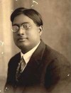
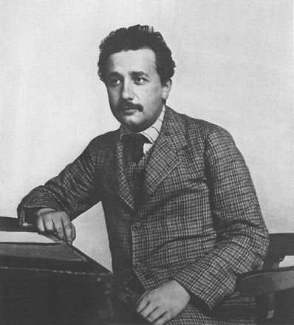
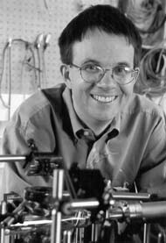
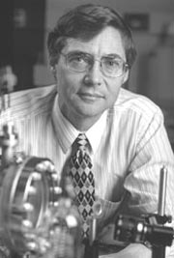
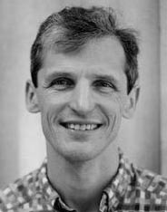
BEC in a dilute gas
In a Bose Einstein Condensate there is a macroscopic number of atoms in the ground state
In 1995 teams in Colorado and Massachusetts achieved BEC in super-cold gas. This feat earned those scientists the 2001 Nobel Prize in physics.
S. Bose, 1924
A. Einstein, 1925
E. Cornell
W. Ketterle
C. Wieman
Light
Atoms
Using Rb and Na atoms
In 2002 around 40 labs around the world produced atomic condensates!!!!

Slide 9
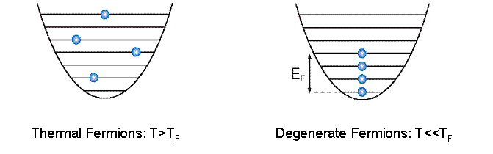
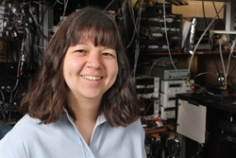
How about Fermions?
At T<T_{f} ~T_{c} fermions form a degenerate Fermi gas
1999: ⁴⁰ K JILA, Debbie Jin group
T=0.05 T_{F}
Now: Many experimental groups:
⁴⁰ K, ⁶ Li, ¹⁷³ Yb, ³ He*

Slide 10
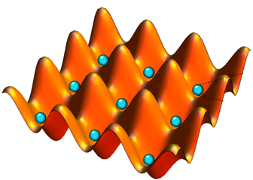
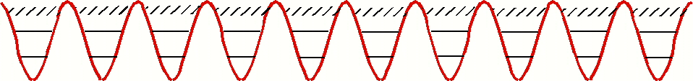
Optical lattices
When atoms are illuminated by laser beams they feel a force which depends on the laser intensity.
Two counter-propagating beams
Standing wave

Slide 11
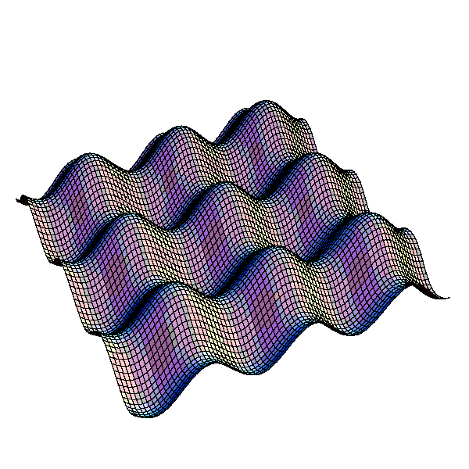
O p t i c a l l a t t i c e s

Slide 12
Why Optical lattices?
Perfect Crystals
Atomic Physics
Quantum Information
Mimic electrons in solids: understand their physics

Slide 13



Slide 14
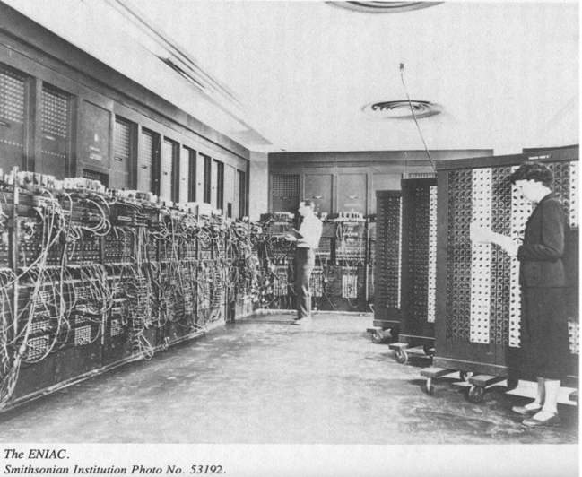

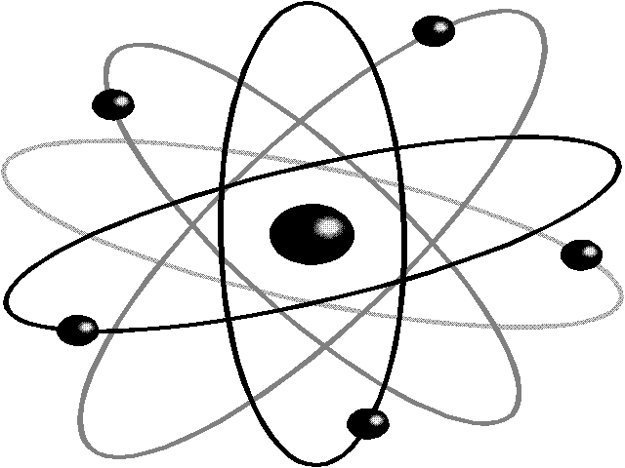
Information
Information is physical!
Any processing of information is always performed by physical means
Bits of information obey laws of classical physics.
Every 18 months microprocessors double in speed: Faster=Smaller
2000
?
1946
Atoms ~
0.0000000001 m
ENIAC ~ m
Microchip ~ 0.000001 m

Slide 15
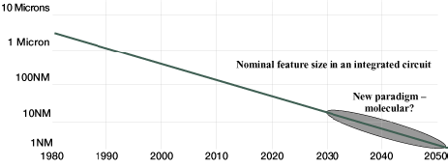
Quantum Computer ?
Size
Year
Computer technology will reach a point where classical physics is no longer a suitable model for the laws of physics. We need quantum mechanics.

Slide 16
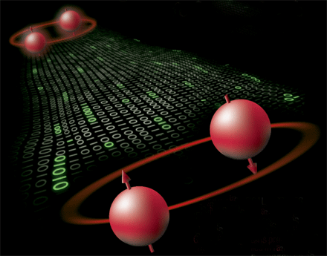
Quantum Weirdness
weirdness

Slide 17
Bits and Qubits
Bits
Fundamental building blocks of classical computers:
STATE: 0 or 1
Qubits
Fundamental building blocks of quantum computers:
STATE: |0 or |1
Definitely 0 or 1
Superposition: a |0+b |1

Slide 18
Bits and Qubits
n 2^{n}
2 bits 4 states: 00, 01, 10, 11
3 bits 8 states
10 bits 1024 states
30 bits 1 073 741 824 states
500 bits More than our estimate of the number of atoms in the universe
A classical register with n bits can be in one of the 2^{n} posible states.
A quantum register can be in a superposition of ALL 2^{n} posible states.

Slide 19
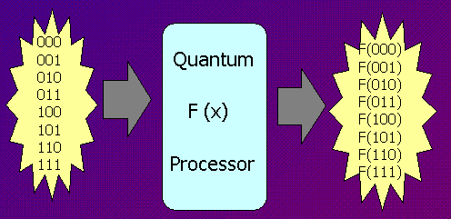
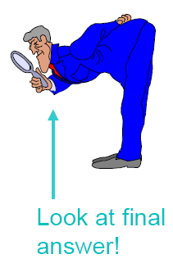
Quantum Paralelism
A quantum computer can perform 2^{n} operations at the same time due to superposition :
However we get only one answer when we measure the result:
F[000] F[001] F[010] . . F[111]
Only one answer F[a,b,c]

Slide 20

Quantum Measurement
Classical bit: Deterministic. We can find out if it is in state 0 or 1 and the measurement will not change the state of the bit.
Qubit: Probabilistic |Ψ =a |0+b |1
We get either |0 or |1 with corresponding
probabilities |a|² and |b|² |a|²+|b|²=1
The measurement changes the state of the qubit!
|Ψ  |0 or |Ψ  |1

Slide 21

What should we do?
Strategy: Develop quantum algorithms
Use superposition to calculate 2^{n} values of function simultaneously and do not read out the result until a useful outout is expected with reasonably high probability.
Use entanglement: measurement of states can be highly correlated

Slide 22
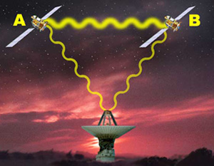
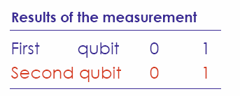
Entanglement
“Spooky action at a distance” - A. Einstein
“ The most fundamental issue in quantum mechanics” –E. Schrödinger
Quantum entanglement: Is a quantum phenomenon in which the quantum states of two or more objects have to be described with reference to each other.
Entanglement
Correlation between observable physical properties
e.g. |Ψ =( |0_{A} 0_{B}+ |1_{A} 1_{B})/√2
|Ψ =|0 0
Product states are not entangled

Slide 23
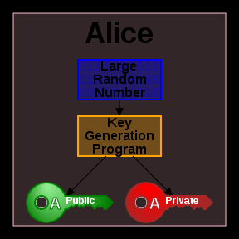
Public Cryptographic Systems
Use mathematical hard problems: factoring a large number
870901
172475846743
198043
Shared privately with Bob

Slide 24



Advantages
Shor's algorithms (1994) allows solving factoring problems which enables a quantum computer to break public key cryptosystems.
Classical
Quantum
870901 x198043
172475846743=?x?
172475846743=

Slide 25

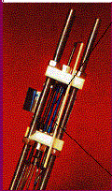
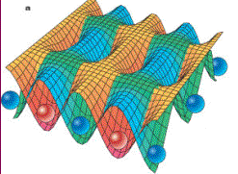
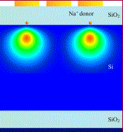
Different physical setups
Trapped ions
Neutral atoms
Electrons in semiconductors
Many others…..

Slide 26
Requirements
DiVincenzo criteria
1. Scalable array of well defined qubits.
2. Initialization: ability to prepare one certain state
repeatedly on demand.
3. Universal set of quantum gates: A system in which qubits can be made to evolve as desired.
4. Long relevant decoherence times.
5. Ability to efficiently read out the result.

Slide 27

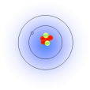
1. Well Defined Qubits
a. Internal atomic states
|1
|0
Internal states are well understood: atomic spectroscopy & atomic clocks.
b. Different vibrational levels
|1
|0

Slide 28
Scalability
Scalability: the properties of an optical lattice system do not change when the size of the system is increased.

Slide 29

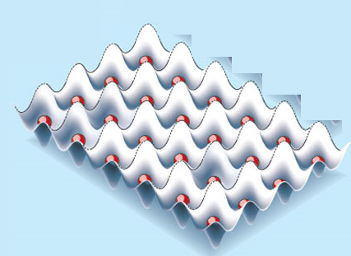
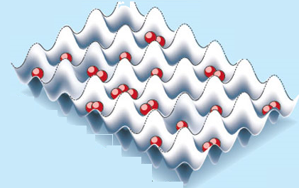
2. Initialization
Internal state preparation: putting atoms in the same internal state. Very well understood (optical pumping technique is in use since 1950)
Motional states preparation: Atoms can be cooled to motional ground states (>95%)

Slide 30
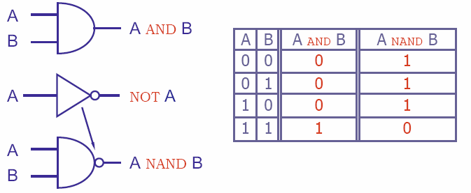
Universality: Classical computer
Only one classical gate (NAND) is needed to compute any function on bits!

Slide 31
Universality: Quantum computer
?
How many gates do we need to make ?
Do we need one, two, three, four qubit gates etc?
How do we make them?
Answer: We need to be able to make arbitrary single qubit operations and a phase gate
Phase gate:
|0 0 |00
|0 1 |01
|1 0 e^{iφ} |10
|11  |11
X
a|0+b|1
c|0+d|1

Slide 32
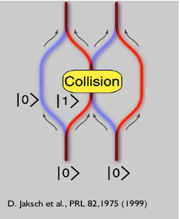
3. Physical implementation
1.
Single qubit rotation: Well understood and carried out since 1940’s by using lasers
|1
Laser
|0
2.
Two qubit gate: None currently implemented but conditional logic has been demonstrated
Collision
|0₁0₂+e^{iφ}0₁1₁+ 1₀0₂+1₀1₁ 
Displace
|0₁0₂+0₁1₁+ 1₀0₂+1₀1₁ 
Combine
|(0₁+1₁)( 0₂+1₂)
initial
|0₁ 0₂

Slide 33
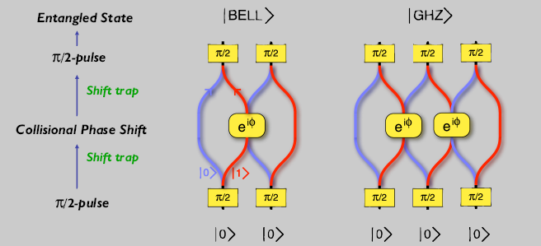
3. Physical implementation
Experiment implemented in optical lattices

Slide 34
4. Long decoherence times
Entangled state
Environment
Classical statistical mixture
Entangled states are very fragile to decoherence
An important challenge is the design of decoherence resistant entangled states
Main limitation: Light scattering

Slide 35
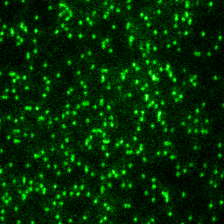
5. Reading out the results
Global: Well understood, standard atomic techniques
e.g: Absorption images, fluorescence
Local: Difficult since it is hard to detect one atom without perturbing the other
Experimentally achieved very recently at Harvard: Nature 462 74 (2009).

Slide 36
Status of Quantum Information
All five requirements for quantum computations have been implemented in different systems. Trapped ions are leading the way.
There has been a lot progress, however, there are great challenges ahead……
Overall, quantum computation is certainly a fascinating new field.

Slide 37
THANKS!!!!

