Slide 1
Quantum Magnetism with Atoms & Ions
Monroe | 10 | Introduction
Spielman | 30 | Synthetic Fields and Fractional Quantum Hall Physics
Duan | 20 | Frustration in Linear Ion Crystals
Bollinger | 15 | Simulations in Large 2D Ion Crystals
 |  | BREAK
Stamper-Kurn | 15 | Spinors and Supersolidity
Rey-Ye | 20 | Molecules and Alkaline Earth SU(N) Magnetism
Freericks | 20 | Molecules and Mixtures: Theory
Chin | 20 | Mixtures in Optical Lattices: Experiment

Slide 2

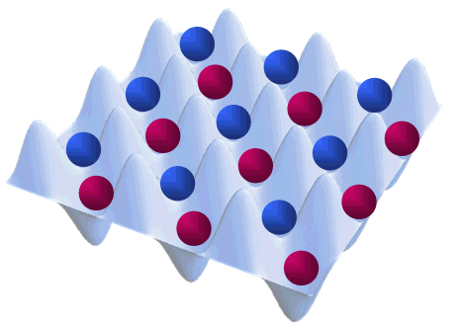
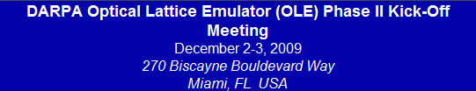
This TALK: JILA Research Efforts
Simulated Quantum Hall Systems
Magnetic ordering in multicomponent optical lattices
(3) Quantum magnetism with long range interactions
Alkaline earth atoms
Polar molecules
Notes:
In this talk I am going to present JILA research efforts and describe how they fit in the three major milestones proposed by the Maryland team.
We will concentrate our work on the exploration of quantum magnetism with long-range interaction using polar molecules and on the investigation of magnetic ordering in alkaline earth atoms systems using both the two clock states of and their nuclear spins as two different type of degrees of freedom.

Slide 3
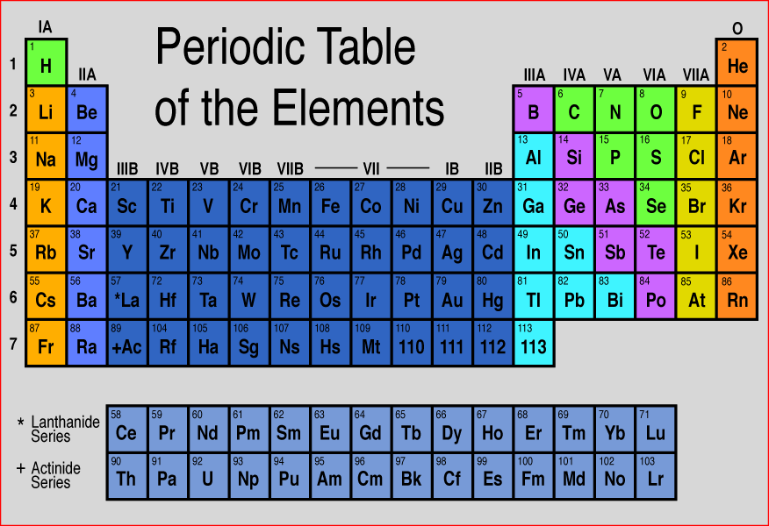
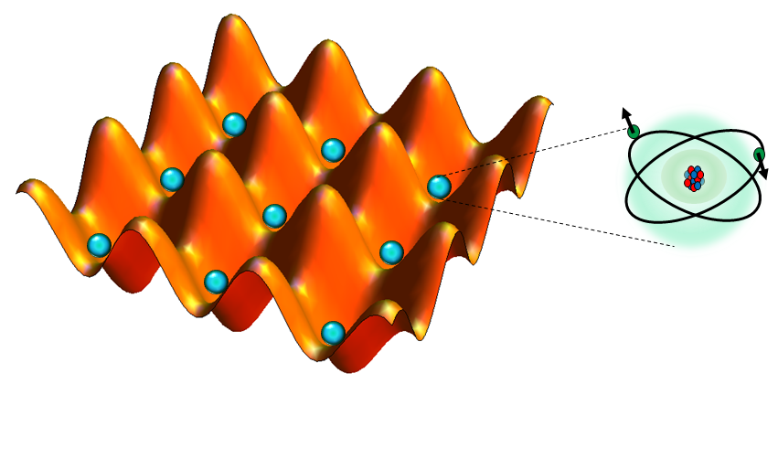
SU(N) magnetism with fermionic Akaline-earth atoms

Slide 4
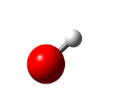
Why alkaline-earth (like) atoms?
Atomic clock experiments
Unique properties
Long lived singlet and triplet states ¹S₀ (g) and ³P₀(e)
J=0 states: Only nuclear spin hyperfine structure, ⁸⁷Sr has I=9/2
Most accurate measurements of a neutral atom-based optical transition frequency:
¹P₁
Cooling down to μK
Trapping in a tight lattice for several seconds
High degree of control over external and internal degrees of freedom
461 nm
(~ 5 ns)
³P₀=e
698 nm
(~ 150 s)
Ye group: Science 314, 1430 (2006).
¹S₀ =g
PRL 98, 083002 (2007).
Science 319, 1805 (2008).
PRL. 101, 170504 (2008).

Slide 5
Optical measurement of Nuclear g-factor
⁸⁷Sr has I=9/2
σ⁻
σ⁺
Ludlow et al, Science (2008)

Slide 6
Why alkaline-earth (like) atoms?
Atomic clock experiments
Unique properties
Few Body Physics
Quantum Simulators
Quantum Information

Slide 7
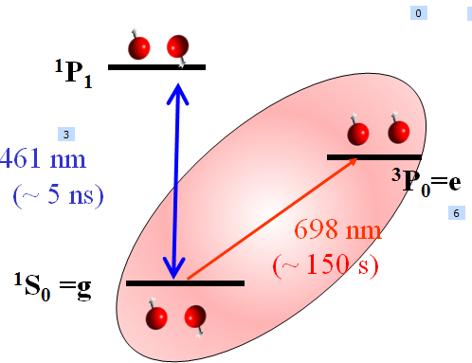
Quantum simulations with AEA
Independent optical lattices for the g and e states (Daley et. al, PRL (2008) ).
J=0 implies that nuclear spin decouples from the electron angular momentum. It leads to SU(N) symmetry N=2I+1, since nuclear spin does not participate in collisions (except via Fermi statistics)
If at t = 0 only a subset of nuclear spin states is populated, spin states outside it will never be populated.
N can be tuned by initial preparation.
e.g. N=4 ↑,↓,,←

A. Gorshkov et al , arxiv: 09052610

Slide 8
Quantum simulations with AEA
CM Hamiltonias beyond the one band Hubbard→ Charge
Spin
Orbital
Transition metal oxides , High-Tc superconductivity
Heavy fermion materials → Colossal magneto-resistance
Quantum criticality Spin liquid phases
Enhanced SU(N) symmetry → No solid state analog
Experimental technologies → Independently manipulate electronic and nuclear degrees of freedom
(Not possible with alkaline atoms).

Slide 9
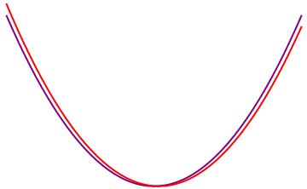
Spin + orbital Hamiltonian
Use ¹S₀ (g) and ³P₀ (e) states as the orbital degrees of freedom
Use nuclear spin I as the internal degrees of freedom
Load them in the lowest band of corresponding optical lattices
For s-wave collisions there are only four interaction parameters
U_{ee}=|ee|s
U_{gg}=|gg|s
U_{eg} ⁺=(|eg+ |eg)|s
U_{eg}⁻=(|eg- |eg)|t
|s : |m₁m₂- |m₁m₂ |t : |m₁m₂+ |m₁m₂
U_{eg}⁺ and U_{eg}⁻ are tunable by displacing the lattices

Slide 10
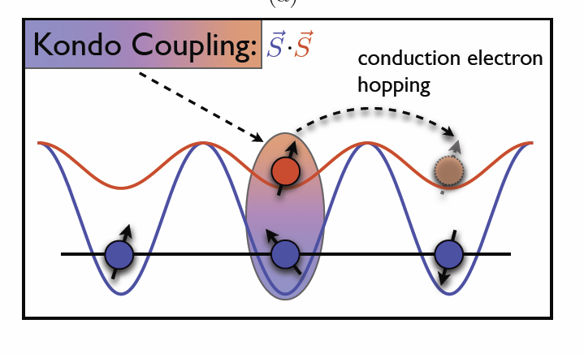
SU(N) Kondo lattice Model
Interactions between a conduction band of delocalized electrons and localized magnetic moments via exchange
For N=2
V_{ex}= (U_{eg}⁺ - U_{eg}⁻ )/2
SU(N) Kondo lattice model
Unit filled deep e-lattice
Low density shallow g-lattice

Slide 11
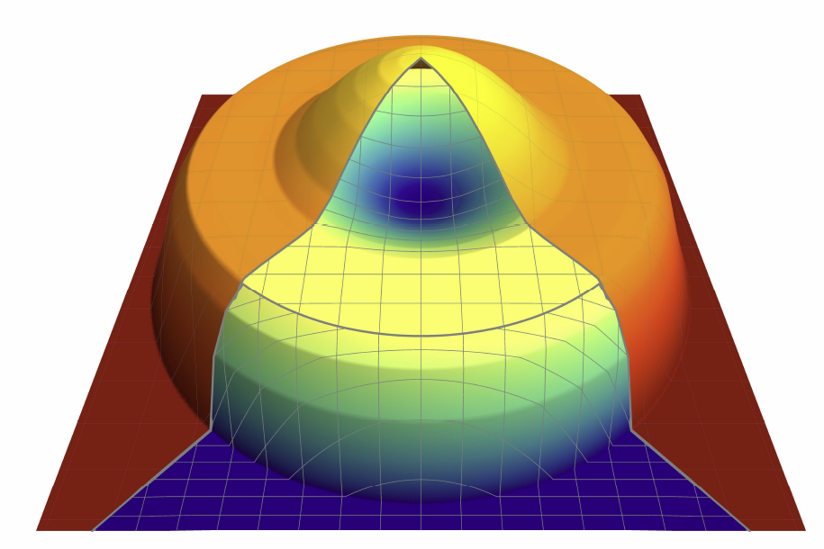
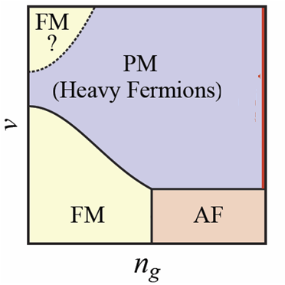
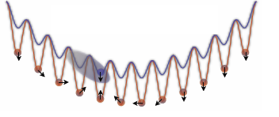
Anti-Ferromagnetic Kondo lattice Model
Shell Structure Kondo Insulator
Possible Phase Diagram
Kondo Insulator
V_{ex}/J_{g}
Slow center of mass oscillations

Slide 12
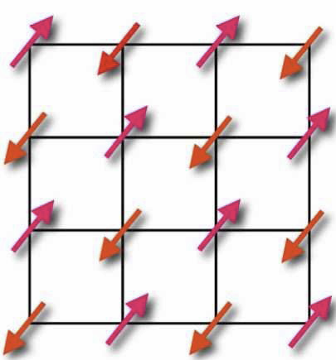
SU(N) Spin models
Mott insulator with one g atom per site and N=2
AF Ground state: Neel Order
Mott insulator with one g atom per site and N > 2
Need N sites to form a singlet: Like quarks
Extensively degenerate ground state
Large fluctuations can destroy magnetic ordering
N5 Chirial spin liquid
Breaks T & P
Spin system counterpart of a fractional quantum hall liquid
Anyons
M. Hemerle, V. Gurarie and AM Rey, PRL (2009)

Slide 13
PHASE II
Novel Physics
Mott phases in transition metal oxides
Large N?
SU(N) Kugel- Khomskii Models
SU(N) Spin Models
SU(N) Kondo Lattice
Models
CSL with non-Abelian statistics?
Detection?
Strongly interacting limit?
Trap + SU(N): rich physics?
Non-equilibrium dynamics?
Orbitally selective Mott transitions
Dependence of the critical U/J value with N?
Experiment: Prepare a quantum degenerate gas in a 3D lattice

Slide 14
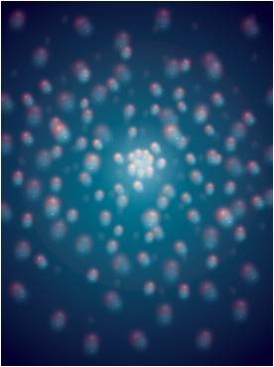
Polar Molecules Near Quantum Degeneracy
Experiment: Jin, Ye
Notes:
The other research milestone is to cool down a gas of polar molecules to quantum degeneracy and use the long ranged and anistropic character of interaction to explore novel physics.
The experimental efforts are led by Ye and Jin groups, which have demonstrated in the recent months impressive and encouraging breaktroughs which I will discuss. Jun is here in the audience and I will speak on his behalf.

Slide 15

Why ultracold polar molecules?
Atoms: interactions are isotropic, short-range
Polar molecules: anisotropic, long-range
E
d² (1 -3 cos² θ)
~ k_{B}T
+
R³
+
θ
-
R
Requires:
Ultra-cold
High density
large dipole moments
-
High phase space density: nλ³
Notes:
Ultracold atomic gases have been demonstrated to be very successful quantum systems
offering high degree of control over internal and external degrees of freedom. However, for most atomic gases interactions are very simple: spatially isotropic and sufficiently short ranged to be well approximated by contact interactions.
However a wider range of many-body physics could be explored if one has at hand a system with more complex interactions. Ideal candidates for that are polar molecules exhibiting long ranged and spatially anisotropic electric dipole interactions.
Atoms with magnetic interactions as chromium atoms also exhibit long range interactions but they are generally more weaker than those found in molecules.
The relative strength of dipole interactions in a gas depend on three parameters: temperature, dipole moment and density. In order to be able to observe interaction effects, the interaction energy must be greater than temperature. This calls for low temperatures and high densities. This can only be met if the gas has a high phase space density: density times deBloglie wave length cube.

Slide 16
Science with cold molecules
Carr, DeMille, Krems, Ye,
New. J. Phys. (May 2009),
Focus Issue on Cold Molecules
Dipolar crystal
Phase transition
& many-body
Dipolar quantum gas
Quantum information
Ultracold Chemistry
12
Molecule optics & circuitry
Cold controlled chemistry
9
log₁₀(density [cm⁻³])
Novel collisions
Fundamental tests
Precision measurement
6
3
log₁₀(temperature [K])
-9
-6
-3
0
Notes:
Until last year direct cooling of polar molecules was limited to mK temperatures. This temperature regime is nevertheless interesting since molecules in the mK-K regime are ideal for investigation of astrophysics and astrochemistry in the interstellar space. The rich structure of molecules can enhance the effect of violation of certain type of symmetries comparable to the case with atoms making them very useful for testing fundamental physics.eg. Permanent dipole moment for the electron.
However to bring molecules to the ultracold regime will open a new window for investigation in a control way phenomena non accessible before such as the formation of self-ensembled dipolar crystals, novel quantum phase transition, dipolar BEC, ultra-cold chemical reactions etc…

Slide 17
Experimental achievements at JILA
A near quantum degenerate gas of polar molecules
Control the entire molecular degrees of freedom, including nuclear spins
Ultra-cold chemical reactions
Dipolar collisions: control elastic/inelastic
Notes:
Recent breakthroughs at JILA have made a very big step towards achieving this goal.
Jin and Ye groups have been able to create an ultracold dense has of potassium rubidium polar molecules near quantum degeneracy in the electronic and ro-vibrational ground state. Further more they have demonstrated the ability to manipulate the entire molecular degrees of freedom including the nuclear spins and prepared in the lowest absolute hyperfine state as well. They have experimentally demonstrated evidence of exothermic chemical reactions in the ultra-cold regime where quantum tunneling is the only possible mechanism collisions can happen. They have also demonstrated the dependence of these ultra-cold collisions on the dipole moments.

Slide 18
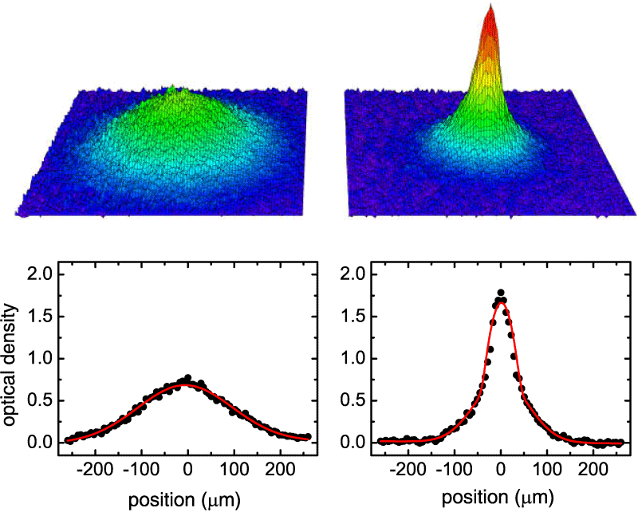
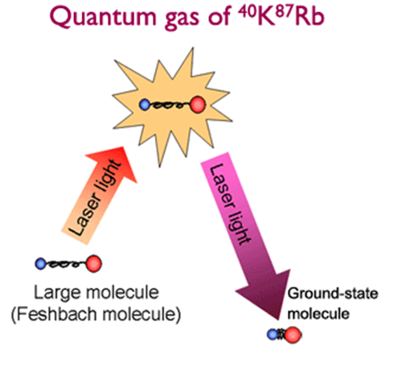
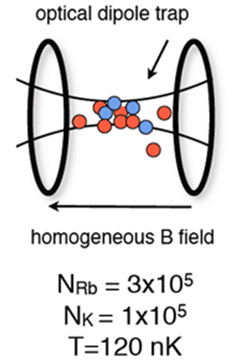
Quantum Gas of polar molecules
Ospelkaus et al., Nature Phys. 4, 622 (2008)
Ni et al., Science 322, 231 (2008)
⁴⁰K Fermions
⁸⁷Rb Bosons
Coherent Transfer
STIRAP
Temperature ~ 160 nK
T/T_{F} = 1.4
Density ~10¹²/cm³
ρ=0.06
d~0.5 D (10¹¹ enhancement)
K. Ni et al.,
Science 322, 231 (2008).
KRb molecules
(Dipole ~0.5 Debye)
Notes:
To prepare this high space density gas of molecules at JILA they started with a high phase-space density gas of two type of atoms: Rubidium (boson) and potassiun (fermion) in an optical dipole trap. The initial atom number is ~ 10^{5.} Using a magnetic-field tunable Feshbach resonance they associated the atoms into ~ 10⁴ extremely weakly bound diatomic Feshback molecules. T~120 nK.
Feshbach molecules are large, loosely bound, and form in the highest vibrational state possible of the ground electronic state.
They efficiently converted without heating the sample these weakly bound pairs into ground state molecules by using a single step of STIRAP (coherent state transfer).
Using Stark spectroscopy they measured a dipole moment of the ground state molecules ~ 0.5 debye. This is ~10¹¹ larger than the original feshback molecules.

Slide 19
KRb Energy Scale
hyperfine(zeeman)
binding energy
rotational
translational
vibrational
trap depth
125 THz
(6000K)
2.2 GHz (0.1K)
800 kHz (38μK)
5μK
350nK
2 THz (100K)
Notes:
Molecules have a complex energy spectrum due to the various degrees of freedom. The highest excitations correposnds to changes in the electronic orbitals involving 100 THz energy scales, vibrational excitations ~ few THz, rotational ~GHz and hyperfine structure ~ MHz at magnetic foelds ~500 G. Note that at this temperatures the hyperfine energy splitting are much larger than the translational energy and therefore spin relaxation to lower hyperfine state becomes an important inelastic scattering mechanism.

Slide 20
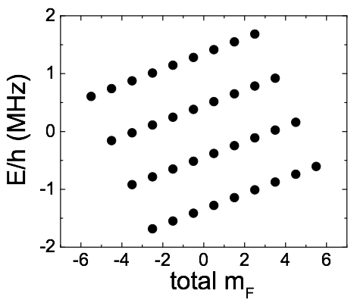
Hyperfine structure for 1Σ (v=0, N=0)
vibration = 0, rotation = 0,
total electronic spin = 0, but with nuclear spins!!
S. Ospelkaus et al.,
arXiv 0908.3931
-4 ← mK → 4
-3/2 ← mRb → 3/2
J. Aldegunde et al. PRA 78, 033434 (2008)
P. Julienne, arXiv:0812.1233 (2008)
Notes:
Since the lowest energy state is a spin singlet state with zero electronic total angular momentum the hyperfine structure reduces to the nuclear substructure. The potassium atoms have I=4 and the Rb atoms I=3/2 which gives a total of 36 possible hyperfine states. At sufficient large fields (B>20 G) the nuclear Zeeman effect dominates over the two nuclear spins and the uncoupled basis is a good basis : the correspondent spin projections onto the magnetic field axis become good quantum numbers. Here there are shown and sorttered by the total projection.
Starting from the Feshbach molecules prepared on the mf=-7/2 state, experimentally it is possible to sellectively populate via two photon Raman process a single hyperfine state. However this state is not the lowest energy state. Using microwave transitions that couple the rotational ground state with a rotational excited state and using the admixture in N=1 of states with different hyperfine states due to the interaction between the nuclear quadrupole moment with the electric field gradient created by the electrons at the nuclear positions, experimentally it is possible to transfer with almost 100 % efficientcy all the molecules to the lowest hyperfine state

Slide 21
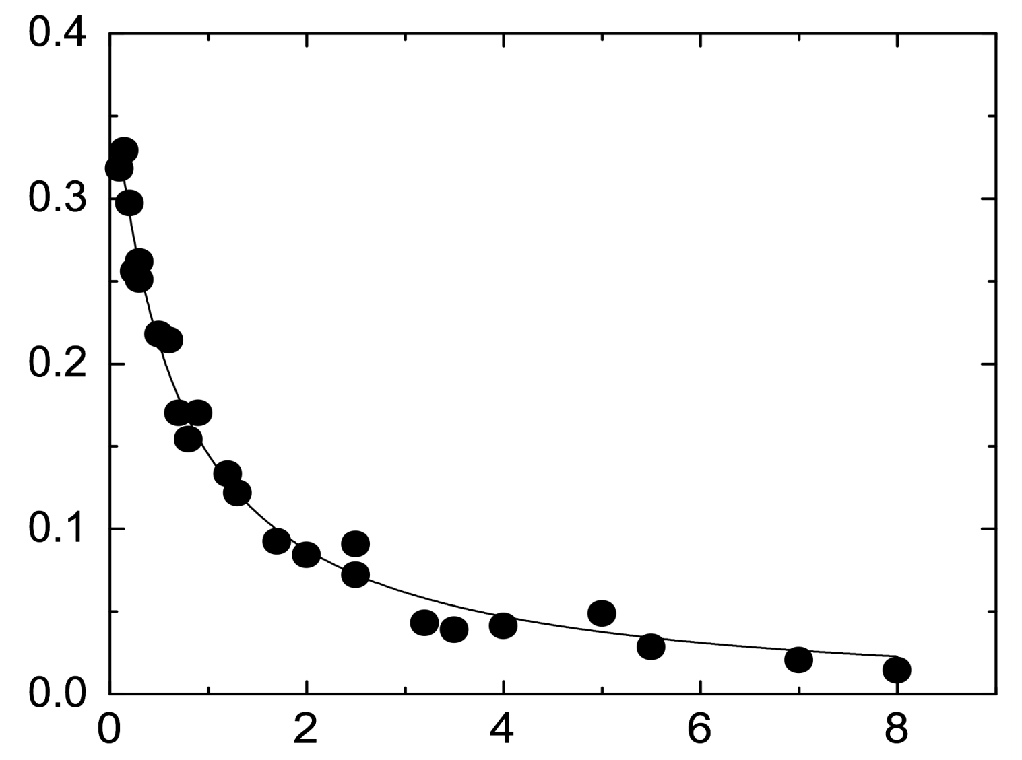
Pure gas of molecules in the lowest energy state
(electronic, vibrational, rotational, and hyperfine)
Two-body loss
can they decay?
Molecule Density (10¹² cm⁻³)
T = 230 nK
β = 4.0(8)x10⁻¹² cm³/s
Time (s)
Notes:
Chemical reactions at ultra-cold temperatures at first glance sound counterintuitive but
they can occur as a wave manifestation of tunneling through angular momentum barriers.

Slide 22

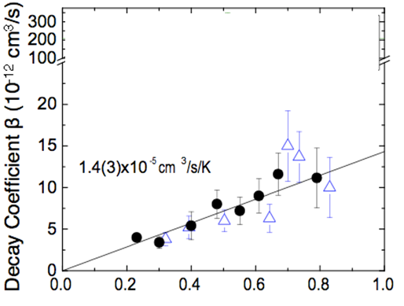

Ultra-cold Chemistry
Exothermic chemical reactions
p-wave collisions
s-wave collisions
Collisional barrier
β (p-wave) ∝ T
No collisional barrier
No suppression
Independent of T
β (s-wave) ∝ const
Temp. (μK)
Notes:
22
When molecules are prepared in the lowest hyperfine state at a temperature of few hundreds of nK experimentally it is observed p wave dominated quantum threshold collisions arising from tunneling through a barrier followed by a near unity probability of short ranged chemical reactions. In the absence of electric field the long range potential reduces to the van der waals potential and those laws predict a rate coefficient linearly dependent on T. When molecules are prepared in two different internal states the reaction rates are enhanced by a factor of 10-100 due to s-wave scattering which does not have a centrifugal barrier. The rate in this case is independent on the temperature. Good agreement between experiment and theory is found.

Slide 23
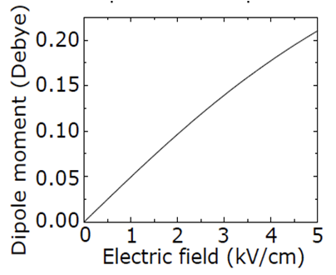
Dipolar Collisions
-1.5 kV
distance
1.3 cm
+1.5 kV
Notes:
In the presence of an electric field a dipole moment is induced. This has been measured by stark spectroscopy.

Slide 24
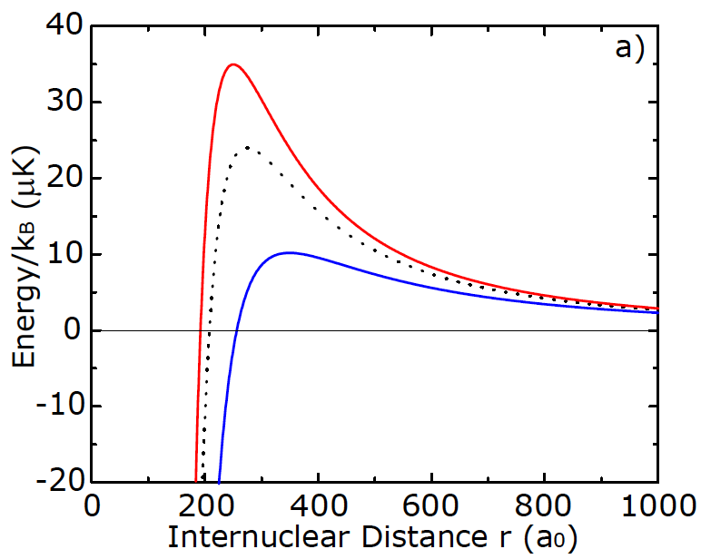
Dipoles & inelastic collisions
p-wave barrier
+
+
_
_
m_{l}=+1,-1
+
_
m_{l}=0
+
_
Collisions in 3D will effectively average over the different channels.
Notes:
24
The C3 coefficient is attractive for molecules colliding in L=1, Ml=0 particla waves and repulsive for the \pm 1 collisions. This implies that while a finite electric field decreases the barrier for ml=0 partial wave collisions it increases the barrier for the others. In 3D collisions will efectivelly averaged out over the three different channels and the losses are going to be dominated by the ml=0 ones.

Slide 25
Tuning the inelastic collisions with d
β~d⁶ (Attractive dipole-dipole interaction)
theory by Quemener and Bohn
β=const.
(van der Waals
interaction)
Notes:
25
It can be predicted using the same threshold laws that in the presence of an electric field the loss rate coefficient grows as \beta=d^6. Theory by Quemener and J Bohn.

Slide 26
Thermalization of Polar Molecules
d = 0
d=0.16 Debye
d=0.084 Debye
E
T_{x}
T_{z}
Anisotropic
Elastic +
Inelastic
(long range)

Slide 27
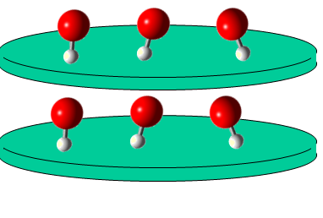
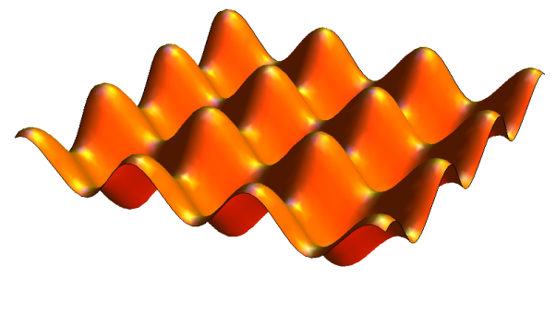
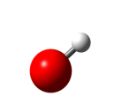

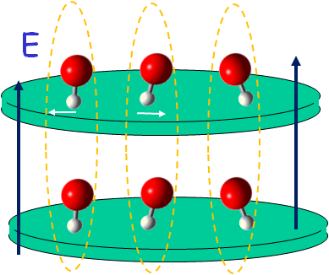
Phase II
1. 2D quantum gas - Suppress inelastic collisions
Only side by side collisions
(repulsive interactions)
Immediate goals
2. Quantum degeneracy via evaporative cooling
3. Add 2D Lattice + E
Super-solid phases, three body interactions, novel phases…
E
4. Layers
Correlated Fermi pairs, Bi-layer Bose condensation… …
5. Control of nuclear spin interactions
Notes:
However if molecules are confined in a deep 1D lattice forming pancakes the ml=0 collisions are suppresed and electric field will suppress quenching collisions. This will make evaporative cooling easier allowing to create an quantum degenerate dipole gas. With that there is rich physics to be probed for example by adding an additional 2D lattice it is possible to simulate rich Hamiltonians which are predicted to exhibit super-solid , Alternative by turning on an electric field perpendicular to the plane one could induce atractive intra –layer interactions en explore new physics such as correleated fermi pairs or bi-layers consensates. Also we are investigating ways to turn on and off nuclear spin interactions at will allowing to explore quantum magnetism.

Slide 28

Technology for cold molecules
Quantum degeneracy
Quantum
degeneracy
~ K_{B}T
12
Coherent state
transfer
Enhanced PA?
Laser cooling?
Sympathetic cooling?
Evaporative cooling?
9
Buffer-gas
cooling
log₁₀(density [cm⁻³])
Stark,
magnetic,
optical
deceleration
6
Photo-association
3
log₁₀(temperature [K])
-9
-6
-3
0

Slide 29
Ultra-cold Collisions
For efficient evaporative cooling elastic collision rates must be faster than inelastic quenching rates
Main inelastic processes:
1. Spin relaxation processes
2. Chemical Reactions:
Avoided : molecules in the lowest hyperfine state
Depend on magnitude and orientation of dipole moment, quantum statistics

Slide 30
Spin + orbital Hamiltonian
Two-band Hubbard model with SU(N) symmetry and fully controllable parameters
Intra-orbital interaction
α=g,e
m=-I,...,I
Inter-orbital direct
V= (U_{eg}⁺+ U_{eg}⁻)/2
Inter-orbital exchange
V_{ex}= (U_{eg}⁺ - U_{eg}⁻ )/2

Slide 31
Coherent two photon Transfer
¹Π
Good Franck-Condon for both
up and down transitions.
Excited state is triplet + singlet mixture
Energy
³Σ
ω₁ (970 nm)
Frequency comb
(φ – stabilized)
ω₂(690 nm)
Sr₂
ω₁
³Σ
6000 K
¹Σ
ν
ω₂
ν= 0, N = 0, J = 0
Inter-nuclear distance R
Notes:
For efficient transfer from the initial state of Feshbach molecules to the final state to tigh ground state molecules the chosen intermediate state electronically excited must have favorable wave function overlap with both initial and final state. Since the Feshbach molecules have a predominant triplet character to reach the singlet rovibrational ground state the intermediate state needs to have also strong electronic spin orbit coupling.
The chosen state was a high lying vibrational level of the exited triplet sigma state which has strong mixing with the excited singlet potential 1 Pi .
The two Raman beams were individually phase locked to a femtosecond optical frequency comb with a phase locked linewidth narrower tha 25 Hz.

Slide 32
Thermalization of Polar Molecules
T_{x}
T_{z}

