Slide 1
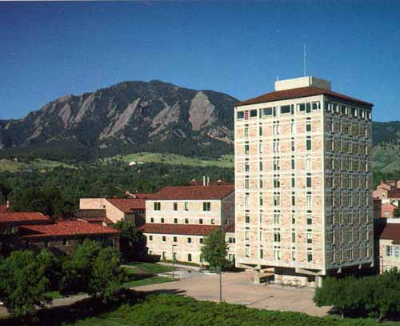

Alkaline earth atoms as quantum simulators of many-body Hamiltonians
PI: Ana Maria Rey
AFOSR grant: 06/10- 06/13, Annual Report

Slide 2
Motivation/Proposed research
Motivation: Why alkaline earth atoms
Alkaline earth atoms as quantum simulators
Alkaline earth atoms and quantum metrology

Slide 3
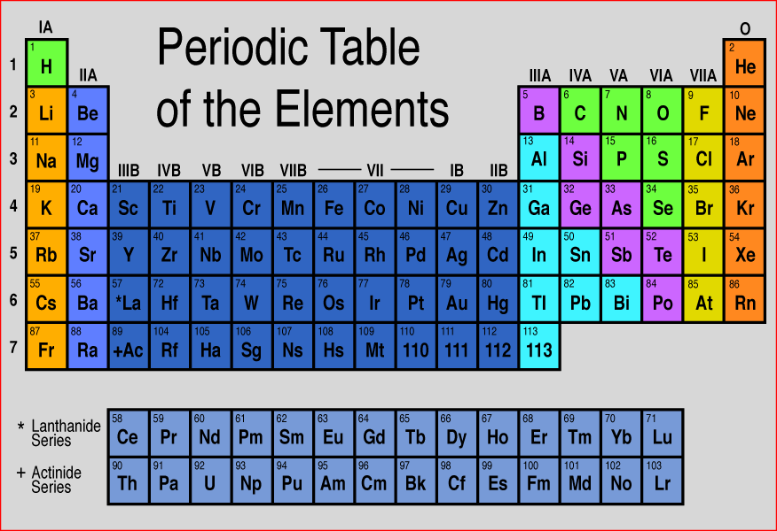
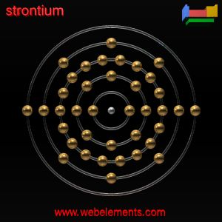
Alkaline Earth (-like) Atoms: AEA
A TALE OF TWIN ELECTRONS
Notes:
Since the core of this talk is on alkaline earth atoms. Let me remind you what AEA are. AEA are those atoms with two outer electrons. Consequently they include those in the second column of the periodic table as well as those one with similar electronic structure such as Yb.

Slide 4
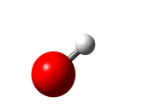
Alkaline earth atoms
Unique atomic structure
Long lived metastable ³P ₀ state: ³P ₀- ¹S ₀ is a dipole and spin forbidden transition with a linewidth ~ mHz .  Spectral resolution
Total electronic angular momentum J=0 → Only nuclear spin I
¹P₁
461 nm (~ 5 ns)
³P₀(e)
698 nm
(~ 150 s)
¹S₀ (g)

Slide 5
Why alkaline-earth (like) atoms?
Unique atomic properties
Atomic clock experiments

Slide 6
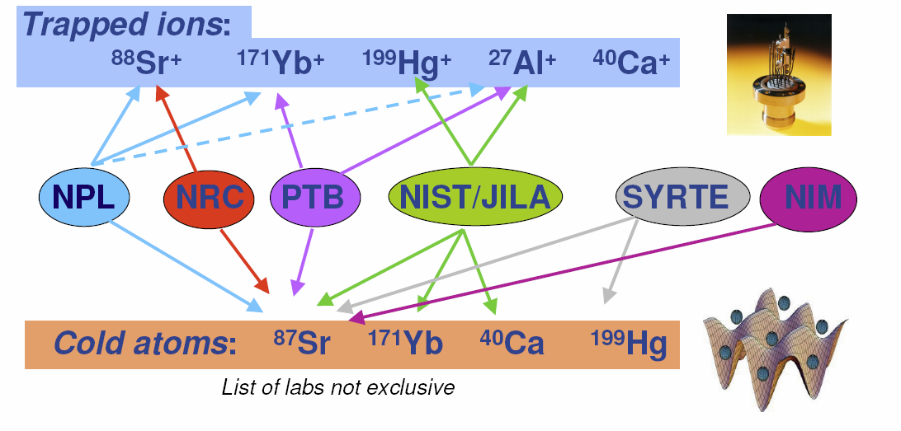
Optical clocks
Accuracy approaching 10⁻¹⁸
Low stability: only single ion
List of labs not exhaustive
Accuracy at 10⁻¹⁶
High stability: many atoms

Slide 7
Why alkaline-earth (like) atoms?
Unique atomic properties
Atomic Clock Experiments
Quantum info/simulation
Fast Recent experimental progress
Takahashi: Tokyo
Killian: Rice University
Schreck/Grimm : Innsbruck
Porto: NIST/JQI
Foelling/Bloch: Max Planck
Dalibard: Paris
Reached quantum degeneracy

Slide 8
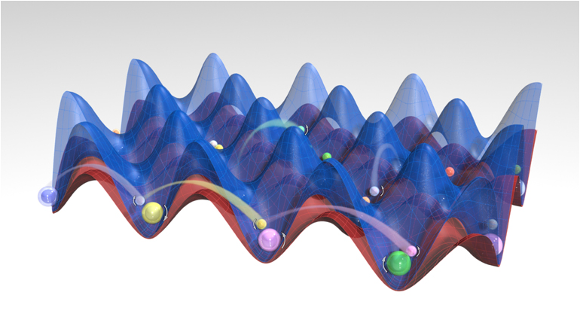
Quantum Simulations with Alkaline Earth Atoms (AEA)
Notes:
8

Slide 9
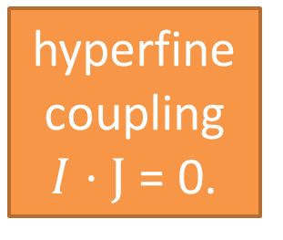
AEA vs Alkali Collisions
alkaline
J
I
Electrons independent of nuclear spin → collisions independent of nuclear spin.
(except via Fermi statistics).
collide
No spin changing collisions. SU(N=2I+1) symmetry
Up to N=2I+1=10
A.Gorshkov,…,AMR, Nature P.(2010) && M. Cazalilla et al NJP (2010)

Slide 10
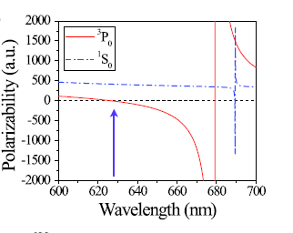
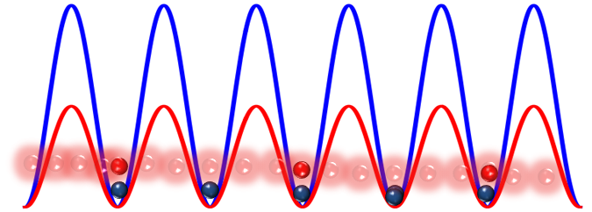
AEA as quantum simulators
1. The ¹S₀ and ³P ₀ clock states have J=0 → No hyperfine coupling.
 Electron angular momentum decoupled from nuclear spins
2. Independent optical lattices for the e and g states, Daley et. al, PRL (2008)
³P₀ (e)
¹S₀ (g)

Slide 11
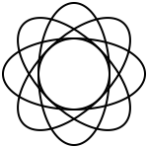


SU(N) Magnetism with AEA
Gorshkov,…,AMR, Nature Physics(2010) && M. Cazalilla, M. Ueda NJP (2009)
Condensed Matter
Alkaline earth atoms
Electron’s Spin
Atom’s Nuclear Spin I
N=2 (± ½)
N=2 I + 1 N<11
SU(2) Symmetry
SU(N) Symmetry
Electron’s Orbital
Atom’s electronic state
¹S₀ and ³P₀

Slide 12
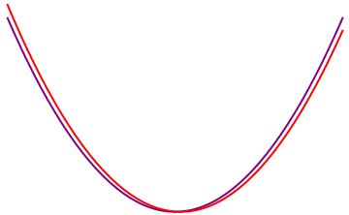
Interaction Parameters
For s-wave collisions there are only four interaction parameters
U_{gg}: |gg|s
U_{ee}:|ee|s
U_{eg}⁻:(|eg- |eg)|t
U_{eg} ⁺: (|eg+ |eg)|s
|s : Anti-symmetric nuclear spin configuration |t : symmetric nuclear spin configuration
Many of those scattering lengths however remain unknown

Slide 13
Two orbital SU(N) Hubbard model
Intra-orbital interaction
Kinetic Energy
α=g,e m=-I,-I+1...,I
Inter-orbital direct interaction
Inter-orbital exchange interaction
V= (U_{eg}⁺+ U_{eg}⁻)/2
V_{ex}= (U_{eg}⁺ - U_{eg}⁻ )/2

Slide 14
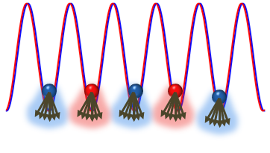
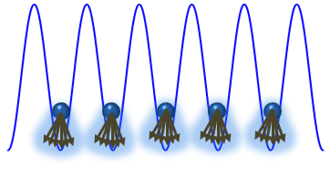
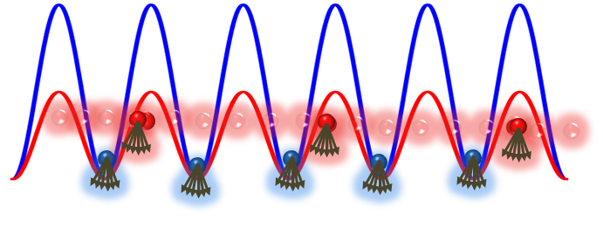
AEA and quantum magnetism
Transition-metal oxides physics and beyond
Quantum Magnetism and beyond: Chiral Spin Liquids, Valence Bond solids,..
SU(N) Heisenberg Models
SU(N) Kugel- Khomskii Models
³P₀ (e)
¹S₀ (g)
Heavy fermion physics and beyond
Gorshkov,…,AMR 1. Nature Physics(2010). Hermele ,….,AMR 2. PRL 103, 135301 (2009). Foss-Feig,..., AMR 3. PRA(R) 81, 051603 (2010). 4. PRA 82, 053624 (2010). 5. PRA 84, 053619 (2011) Manmana,….,AMR 6. PRA 84, 043601 (2011) . Hazzard,…. ,AMR 7. arXiv:1011.0032.(Accepted PRA(R))
SU(N) Kondo Lattice Models
Notes:
[Ana Maria] Alkaline earth atoms have opened a new arena for simulating strongly correlated condensed matter (CM) models. The enhance Su(N) symmetry allows us to explore new models which we can not find in real solid state materials.
For example we can simulate
1. Quantum magnetisms and using the su(N) symmetry new states of matter long sought in CM but never found so far such as a chiral spin liquid. This state is a bother of the quantum Hall state and exhibits unique topological properties.
2. We can simulate Kugen-Khoskii models used to describe transition metal oxides and generalize them from Su(2) to SU(N).
3. Similarly we can simulate the Su(N) variant of the Kondo lattice model. The SU(2) version is believed to describe heavy fermion compounds. These compounds exhibit a rich phase diagram far from being understood.
14

Slide 15
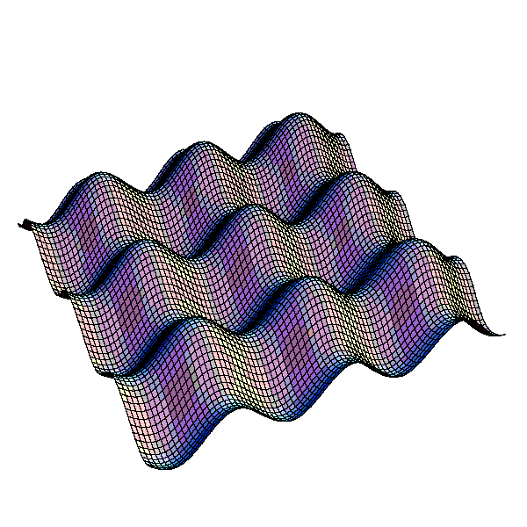
SU(N) Hubbard model
Requirements: Only g atoms in an optical lattice
: Creates a g atom
at site i with spin α
Assumptions: Lowest band, Short -range interactions, Nearest neighbor hopping
J_{g}
W(x)
U_{gg} a_{gg}
i
i+1

Slide 16
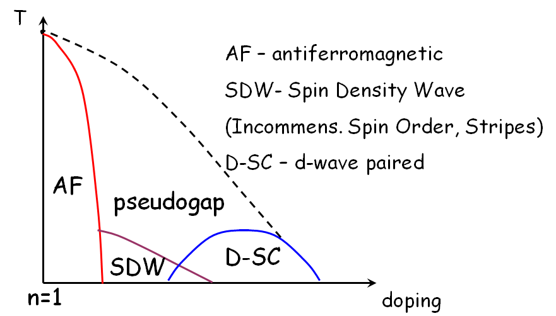
Even SU(2) Hubbard Model is very complex
Its phase diagram in 2 and 3 dimensions for N=2 remains unknown
Possible phase diagram
Notes:
Paramagnetism: Not net magnetization present in the absence of an external applied magnetic field

Slide 17
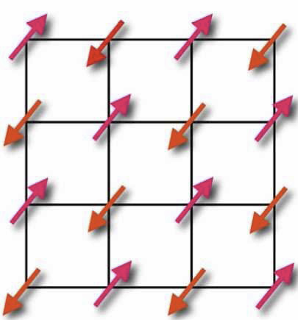

SU(2) Hubbard maps to a spin ½ Heisenberg Model at half filling
Long range antiferromagnetic order (Néel state)
This is known numerically and experimentally.
How about the SU(N)-Hubbard?

Slide 18
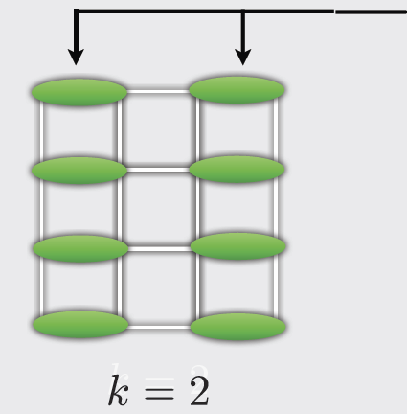
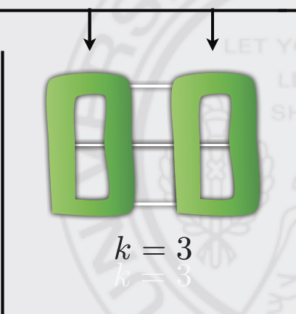
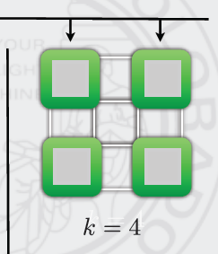
Large N phase diagram
M Hermele, V Gurarie, AMR, PRL 103 135301 (2009).
k: The number of sites required to form a singlet
k<5: valence bond solids This state
k5 Chirial spin liquid: long-sought exotic (topological, spin liquid, …) state
Affleck &Marston (1989)
6-spin singlets
(new result)
4-spin singlets
(new result)

Slide 19
1D SU(N) Phase diagram
S. Manmana1, K. R. A. Hazzard, G. Chen, A. Feiguin, and AMR Phys. Rev. A 84, 043601 (2011)
Computed the 1D SU(N) Hubbard model phase diagram: using the density matrix renormalization group (DMRG), Bethe ansatz (BA), and bosonization.
Used the DMRG to benchmark the Bethe ansatz (BA). For N >2 the BA is only approximate: Relative error found < 4%
Determined regimes of validity of strong- and weak-coupling perturbation theory for all values of N.
Investigated the BKT transition from a Luttinger liquid to a Mott insulator: For N>2 confirmed the transition occurs at a finite U>0. For N=2 at U=0

Slide 20
Determination of critical point based on fidelity susceptibility
S. Manmana1, K. R. A. Hazzard, G. Chen, A. Feiguin, and AMR Phys. Rev. A 84, 043601 (2011)
Fidelity susceptibility
Critical points
Minimum determines critical point
Fidelity susceptibility
U/J_{g}

Slide 21
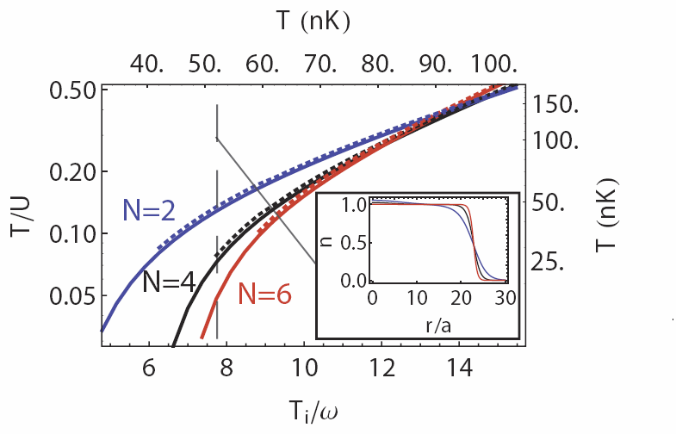

Thermodynamics of the SU(N) Hubbard model
KRA Hazzard, V Gurarie, M Hermele, AMR, Accepted PRA Rapid
Assuming standard adiabatic loading, from a degenerated quantum gas in a trap to a deep lattice, we computed the final temperature of the gas vs N.
Used high temperature series expansion, valid when the Temperature is larger than tunneling (experimentally relevant regime).
Found substantial cooling with increasing N
density
Outlook: Preliminary calculations using Quantum Monte Carlo predict this cooling effect survives for temperatures below tunneling (in preparation).

Slide 22
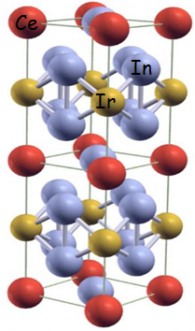

Heavy Fermion Materials
Are a specific type of metallic compounds containing rare-earth or actinide elements
At low-temperature exhibit a specific heat whose linear term is up to 1000 times larger than the value expected from the free-electron theory.
This enhancement can be accounted within the effective Fermi liquid picture by the development of heavy quasi-particles.
Notes:
The term Heavy fermion was introduced in the seventies, And was brought to describe a class of mettallic compounds with very large effective masses.
Materials of this class are compounds containing rare earth and actinide elements

Slide 23
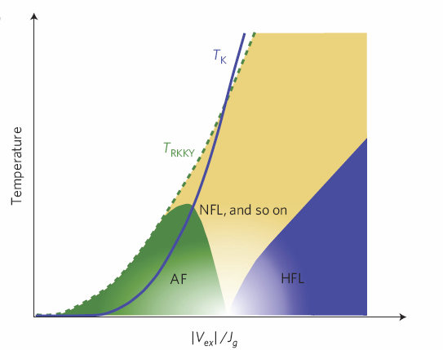
Rich Phase diagram
However the Heavy fermi liquid is just one of the various ground states exhibited by this compounds.
Heavy fermions exhibits a very complex phase diagram, many aspects of which remain unknown
Quantum criticality and non-Fermi liquid behavior
Temperature
Exotic Superconductivity
Magnetic order
Heavy Fermi liquid
SC
Control Parameter
Gegenwart et al, Nature Phys. 4, 186197 (2008).

Slide 24
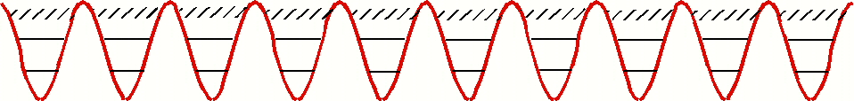
Kondo Lattice Model
The Kondo Lattice model is the iconic model used to describe Heavy Fermions
Basic Physics: A band of conduction electrons (c-electrons) interacting via exchange interaction with localized magnetic moments (f-electrons).
c
f

Slide 25
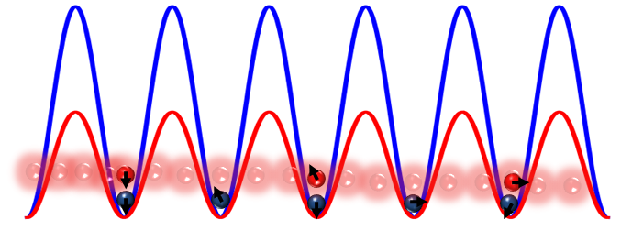
Implementing the SU(N) KLM
Deep ³P₀ lattices with one atom per site: (role f electrons)
Shallow ¹S₀ lattice : (role of c electrons)
N can be controlled by initial preparation
V_{ex} can be tunned by displacing the lattices
V_{ex}= (U_{eg}⁻ - U_{eg}⁺ )/2
V_{ex} and U_{gg} are independent parameters, Yb ¹⁷¹ has U_{gg}=0
Foss Feig , Hermele, AMR, PRA (Rapid) 81, 051603 (2010)

Slide 26
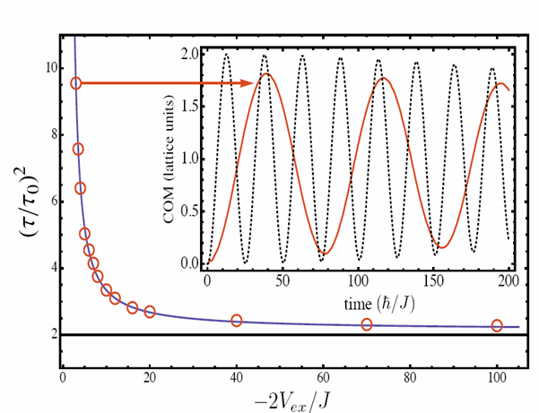
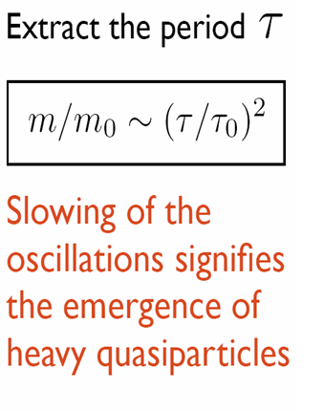

Probing Heavy Fermion Physics
Foss Feig, Hemerle, AMR, PRA 81(R), 051603 (2010)
We employed a time dependent inhomogeneous extension of priorly derived mean field theories used to describe the Kondo Lattice model and studied the dynamics in the trap.
*

Slide 27
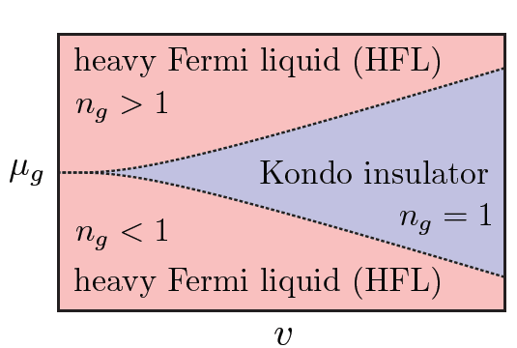
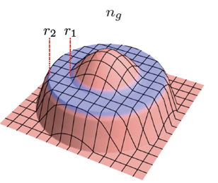

Mean Field diagram in a trap
Foss Feig, Hemerle, Gurarie,AMR, PRA 82, 053624 (2010)
We also use the Local Density Approximation at equilibrium:
The Kondo insulator leads to the formation of a shell structure in the density profile
± Δ_{Η}/2
Density Profile

Slide 28
Many body physics with clocks
Unique atomic properties
Atomic Clock Experiments
Quantum info/simulation
AMR et al PRL (2009);
M. Swallows,…AMR, J.Ye, Science (2011);
M. Bishof,...AMR, J Ye, PRL (2011);
N. Lemke,…AMR, C. Oates, PRL 107, 103902 (2011);
M. Bishof,…, AMR, J. Ye, PRA 84, 052716 (2011) ;
A. Ludlow,…, AMR, PRA 84, 052724 (2011) .

Slide 29
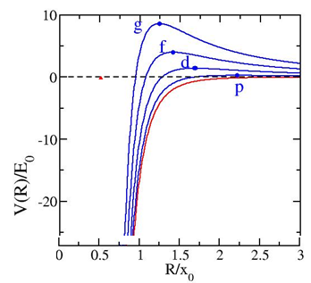
Collisional frequency shift
Interrogation of a large number of atoms enhances clock sensitivity but atomic collisions degrade its precision.
To minimize density shift the use of fermionic spin polarized isotopes was proposed.
| ³P₀= e⟩
ω₀
ω₀+ Δω
Δω: density shift
| ¹S₀ = g⟩
s-wave: l=0
p-wave: l=1
Atoms collide via the lowest partial waves
| g⟩
| g⟩
| g⟩
| g⟩
Can NOT collide
Can collide
Notes:
The most precise atomic clocks in the world are currently based on single trapped ions.
However in contrast to single ions neutral atoms based clocks have the potential of very high sensitivity due to the simultaneous interrogation of large number of atoms. This is why it is believe they can overcome the precision of the ion clocks but at the cost of dealing with density shifts that arise due to interatomic interactions.
It was believed that the problem of dealing with interactions could be overcome by using polarized fermionic atoms. These are immune to s-wave collisions, which are the dominant interactions at low temperature.
However even using these atoms density shifts were measured both at JILA in Sr and at NIST in Yb. The magnitude of the shift was so large that density shifts were measured to be the second largest systematic error of the clocks.

Slide 30
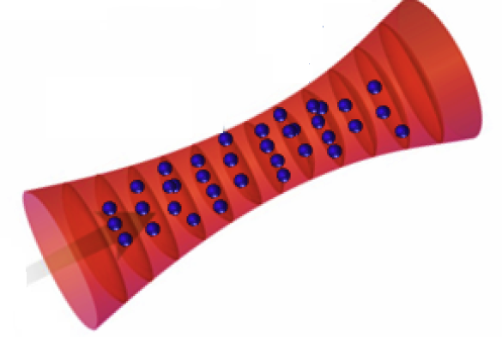

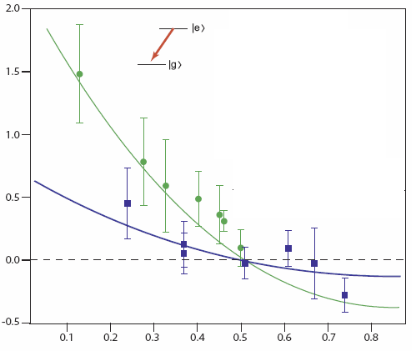
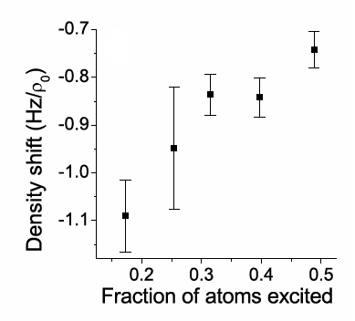
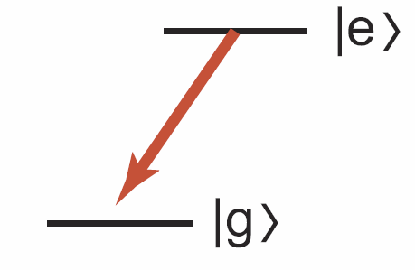
1D lattice
However even for identical fermions density shifts were measured and give the second largest contribution to the current 10⁻¹⁶ uncertainty in optical lattice clocks
JILA:G. Campbell et al Science 324, 360 (09)
NIST: N. Lemke et al PRL 103,063001 (09)
2.0
Sr
Yb
1.5
1 μK
3 μK
1.0
0.5
10 μK
0.0
-0.5
0.1
0.2
0.3
0.4
0.5
0.6
0.7
0.8
Fraction of atoms de-excited
Notes:
Here I am just presenting the reported measurements. They were carried out in a 1D lattice at the magic wavelength. The left plot is for Sr and the right plot for Yb.
The figures show the magnitude of the measured shift vs excitation fraction. In Sr they interrogated the e to g transition and the g-e in Yb. The magnitude of the shifts were of the order of 1Hz for the corresponding densities. Yb operated at a higher temperature ~10 microK compared to Sr which was operated at 1 and 3 micro K temperatures.

Slide 31
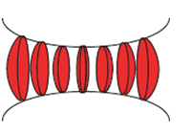
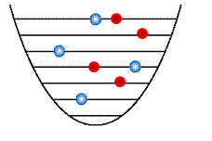
Collisional Shifts
Initial reasoning: P-wave interactions suppressed by two orders of magnitude compare of s-wave → s-wave must be dominant
b³: p-wave scattering volume
a_{s} : s-wave scattering length
T= 1 μK
How can we have s-wave interactions for identical fermions?
Answer: Excitation Inhomogeneity
x
Transversal
Cause by a slight misalignment of the probe beam from the lattice direction
z

Slide 32
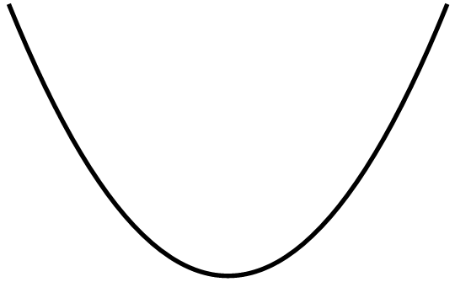
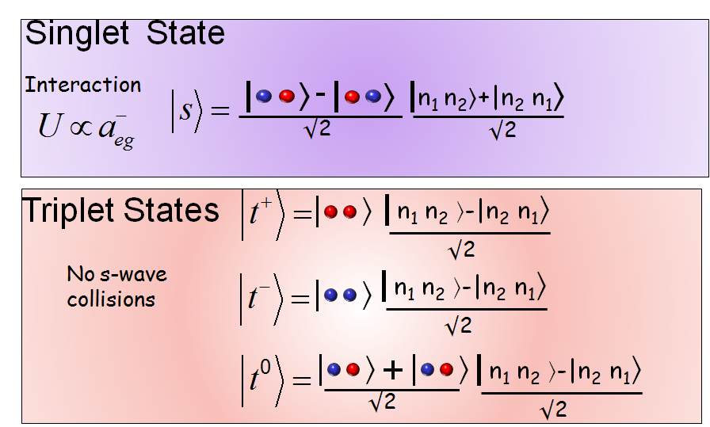
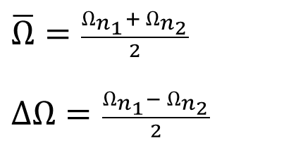
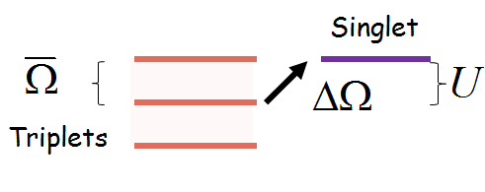
Two atom - two modes
n₂
n₁
Transfer from triplets to singlet leads to a density shift
AMR et al PRL (2009); Swallows,…AMR, J. Ye, Science (2011); M. Bishof ,...AMR,J Ye, PRL (2011)
Gibble PRL (2009), Yu et al PRL (2010)

Slide 33
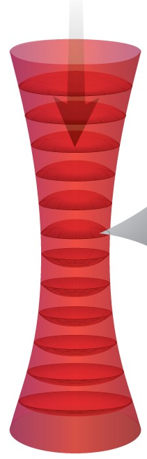
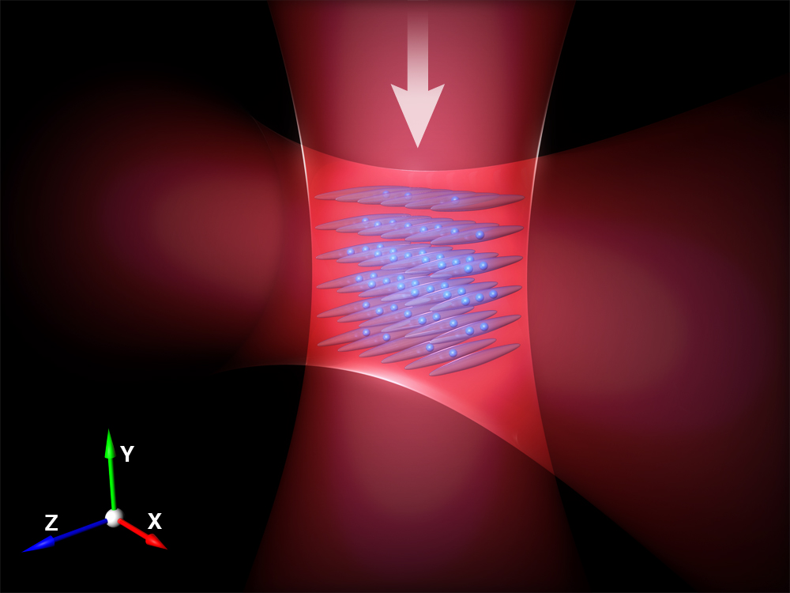
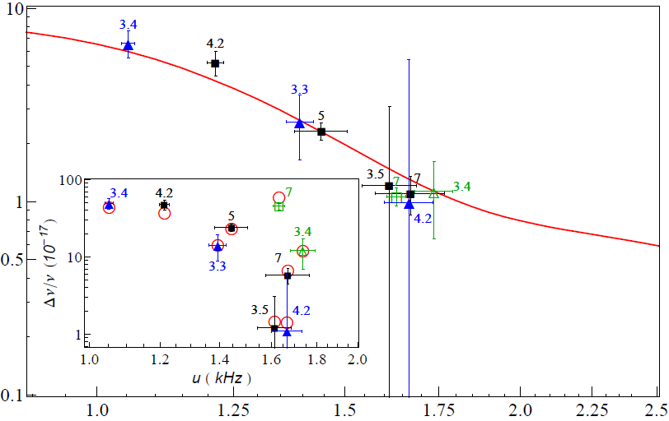
Suppression by strong confinement
U ∝ (ω_{x} ω_{y} ω_{z} )^{1/2}
1D Lattice
2D Lattice
Theory
Fractional frequency shift ( 10⁻¹⁷ )
Δν/ν=(0.51.7) 10⁻¹⁷ .
Swallows et al.,
Science 331, 1043 (2011).
24
30
36
42
48
54
60
Atomic interaction energy (Hz)
Notes:
Actually in the experiment they we able to increase the interaction energy by almost a factor of ten by going from a 1D lattice to a 2D lattice, from an array of pancakes to an array of tubes. They actually did see the suppression of the shift by almost a factor of ten for some operating conditions in the 2D lattice.

Slide 34
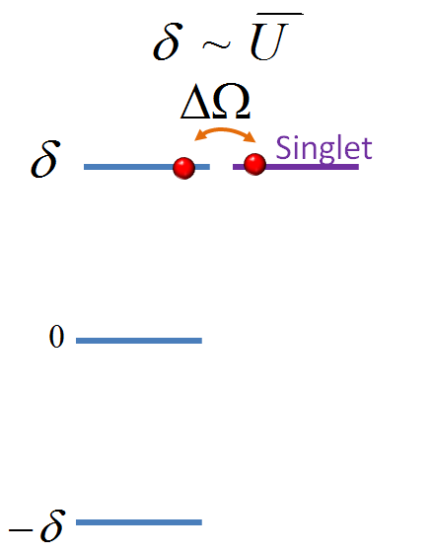
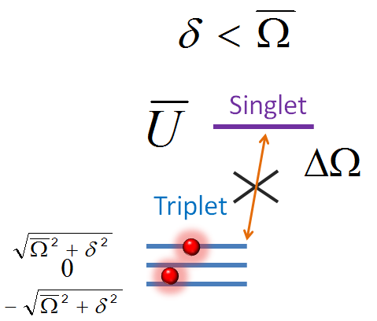
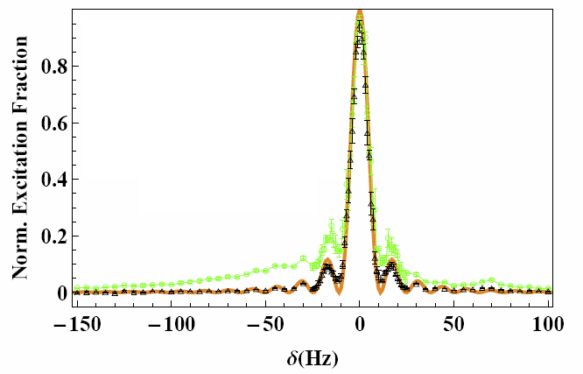
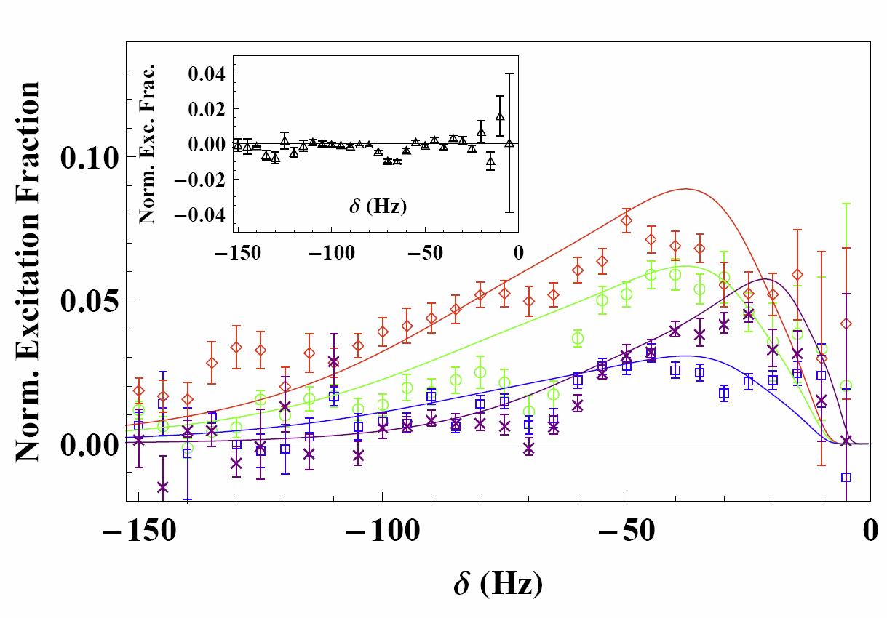
Reaching the strongly interacting regime
Reaching the strongly interacting regime
Interaction sideband
Subtracted line shape after reflection
line shape
2D lattice
1D lattice
ISB
M. Bishof et al PRL:106, 250801 (2011)
Notes:
So far we have only explored the carrier, i.e small detunnings but the same simple model predicts further physics. In the strongly interacting regime if one increases the detunning to a magnitude comparable to U, then once again one could make the singlet state resonant and thus one should see another resonance at these detunnings.
This is actually what was seen in the experiment. When they went to the 2D geometry they observed the presence of an interaction sideband. At the micro K temperature in which they operate the sideband was resolvable but broad. Specially due to the different trapping frequency experienced by the tubes due to the Gaussina beam profile.
To resolved the ISB better we subtracted the right side of the lineshape which was free from interactions effect from the left side. Comparisons of different conditions to theory is shown in the plot.
On the contrary in the 2D lattice no signature of ISB was observed.

Slide 35
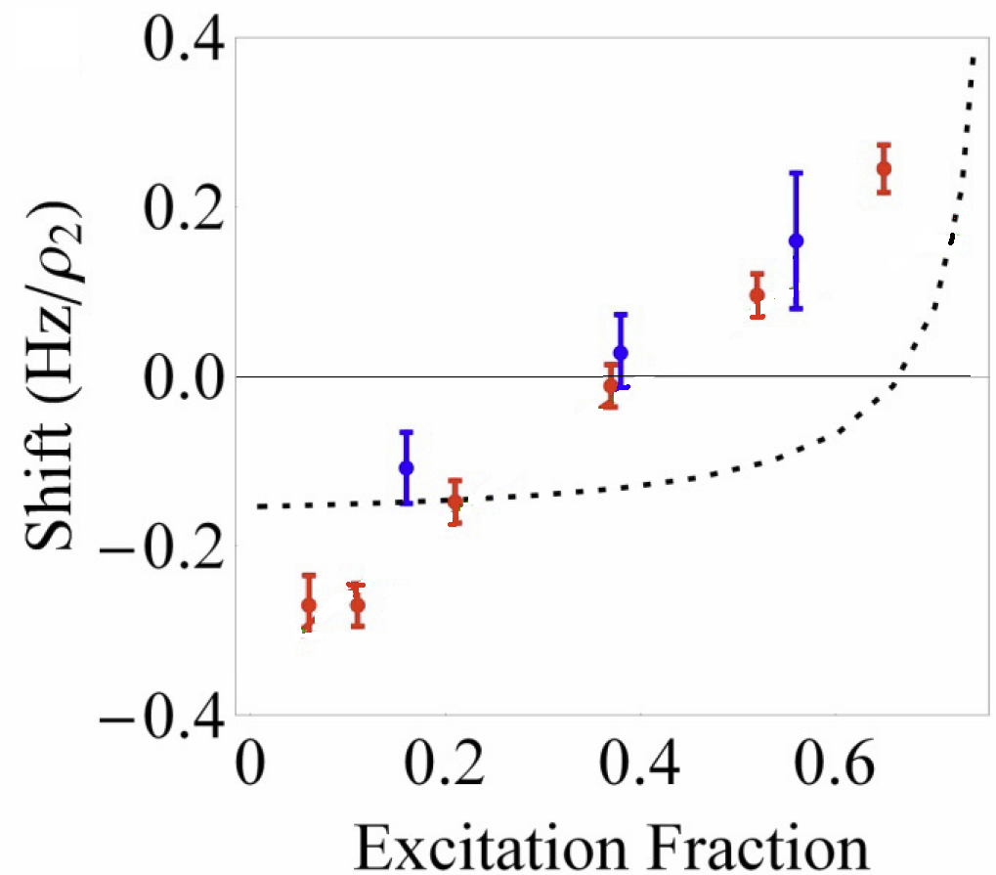
Yb Ramsey Measurements
2D lattice
2D Lattice
Only singly and doubly occupied lattice sites
S-wave disagreed ☹
N. Lemke,…AMR, C. Oates 107, 103902 (2011)
Notes:
Every thing was thought to be very clear at that time until I was asked by the Yb group to perform theory comparisons with their Ramsey data. Just a reminder, in Ramsey spectroscopy the atoms are firstly transfer from g to e with a short pulse, then they are allowed to evolve and finally the are rotated one more time and the total excited population is measured. In Ramsey the vary the excitation fraction by controlling the short pulse area. These are measurements of the shift vs excitation fraction.
The dashed line is the predictions from the s-wave model.
What was going on?
Initially we though that because Yb was at higher Temperature then tunneling in higher populated bands was the issue. However they changed the direction of interrogation from vertical to horizontal. One with gravity one without gravity and thus with substantial different tunneling properties and no drastic changes were observed.
Also we though it could be mode changing collisions due to the fast pulses but no major differences where observed by substantially varying the pulse area.

Slide 36
Revisiting p-wave vs s-wave shifts
Assuming b~a_{s}~100 a_{o} T~1 μK
P-wave interaction might be as relevant as s-wave !!
Two-atom model
Triplets can interact via p-wave (just like bosons in s-channel)!
Three additional parameters V_{ee},V_{gg}, V_{eg}
Notes:
We then decide to revisited the ratio between p to s wave interactions done before. What we realized is that the quantity that needs to be compared is not the actual value of the interactions but the magnitudes of the shifts themselves. If this is done one immediately sees that since s-wave shifts only occur with excitation inhomogeneity their magnitude is suppressed by a factor (\Delta \Omega/\Omega )^2 and for typical (\Delta \Omega/\Omega )~0.1 the magnitude of the s-wave and p-wave contributions could be of the same order.
So we just generalized our toy two atom model to include p-wave interactions. There are in principle three different p-wave interaction parameters. Vee, Vgg and Veg. When one looks at the Eqs. one immediately sees that restricted to the triplet manifold these are exactly the equations for two bosonic atoms interacting via s-wave.

Slide 37
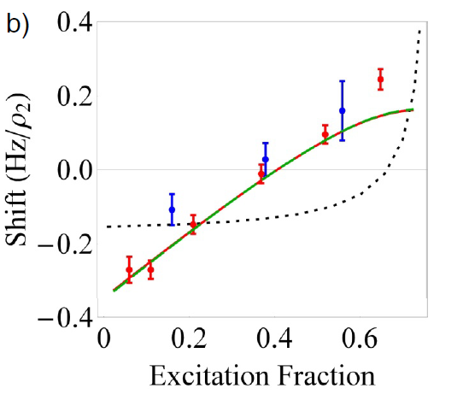
Comparison with p-wave two atom model
2D lattice
Pure p-wave
Lemke,….,AMR, C. Oates, PRL 107, 103902 (2011)
Notes:
We now used the p model to compare with the experiment, and found that actually a pure p-wave model well reproduced the experiment. Also we looked at the lineshape and found indications of ISB. The origin of the ISB in the p-wave case has different physical origin. The carrier is mainly due to single occupied tubes and the sidebands originate from the shifted lineshapes of doubly occupied tubes. P-wave theory is the solid curve.

Slide 38
Important P-wave inelastic losses in 1D lattice
ee-losses
eg-losses
Density ~ 10¹¹cm³/s
 | ee loss rate | eg loss rate
Yb @10 μK | 5 ×10⁻¹¹cm³/s | 3 × 10⁻¹¹ cm³/s.
Sr @5 μK | 2 ×10⁻¹¹cm³/s | < experimental sensitivity
Ludlow,… ,C. Oates, AMR PRA 84, 052724 (2011)
Bishof, …, AMR, J. Ye PRA 84, 052716 (2011)

Slide 39
Probing losses/interactions in a 1D lattice
In a 1D lattice there are N~5-30 atoms per pancake: mesoscale
Both inelastic and elastic interactions are weak ~ 1Hz
Probing for long enough times we can actually see them and understand their interplay
New laser at JILA allows up to sec interrogation times
Notes:
Finally in the time that I have left let me say a few words about Sr. Actually recent measurements have also found important p-wave losses. They found a decay rate coefficient between ee atoms of the order of 10^-11 cm^3/s at micro K temperatures. Under current experimental uncertainties they on the other hand have not found important p-wave losses due to g-e collisions.
They have made significantly improvements in their laser stability and are now able to enhance their probing time from 80 ms to sec. This means that even in the 2D lattice they can now reach a regime where interactions are of the order of or larger than the mean rabi frequency. Using our bosonic hamiltonian we have developed a mean field density matrix treatment of the dynamics which propertly accounts for the two body losses. The formalism reduces to the standard GPE if losses are set to zero.
Using it and accounting with just p-wave elastic and inelastic collisions we have been able to reproduced very well the measured lineshapes in the 1D lattice. The calculations revealed that actually p-wave intections completely dominate the line shape profile in the case of the 1D lattice with multiple atoms per pancake.

Slide 40
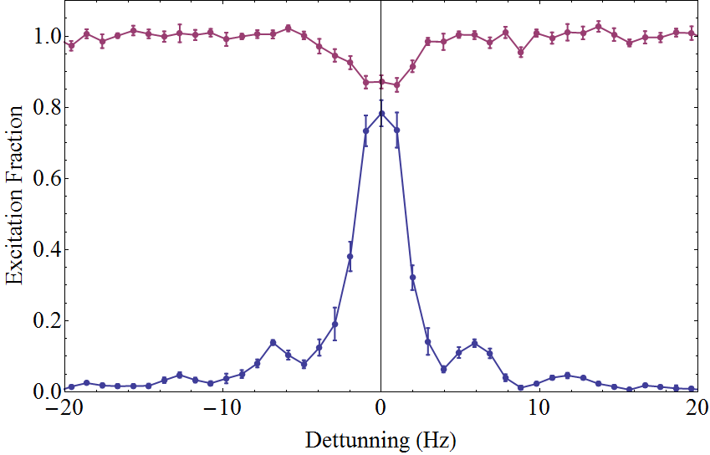


Probing losses/interactions in a 1D lattice
Ω=2π x 2.5 Hz
<< N
Excitation fraction
Normalized atom number
Ω=2π x 2.5 Hz
N_{T} =1500
N_{T} =7000
<< time
Development of sidebands with increasing atom number
Ω=2π x 0.7 Hz
Suppression of excitation and losses during clock interrogation as
density increases and
Rabi frequency decreases,
N_{T} =6000
??? Theory at rescue

Slide 41


Dealing with a mesoscopic open system
From N=2 to many
Basic idea:
Only spin degrees of freedom: Frozen motional degrees of freedom
Derive an effective spin model
Derive a mean field master equation
 ↑ 
  *

Slide 42







Theory/Experiment
Excitation fraction (Normalized)
Atom number
(Normalized)
Detuning (Hz)
Detuning (Hz)

Slide 43


Ramsey Spectroscopy
Yb: Zeroing of the shift at the 10 ⁻¹⁸ level by operating at 51% excitation!!
Linear dependence of Ramsey spectroscopy with pulse area is consistent with a dominant p-wave contribution

Slide 44

Many body physics with clocks
Unique atomic properties
Atomic Clock Experiments
Quantum info/simulation
Many-body Physics can lead to a significant improvement of clock sensitivity
Clocks can help to determine microscopic parameters of the many-body Hamiltonian.

Slide 45
Conclusions && Outlook
Alkaline-earth atoms offer outstanding possibilities for the implementation of novel many-body Hamiltonians.
Unique capabilities of optical clocks offer the possibility of studying a:
Strongly interacting mesoscopic open driven quantum system
Can we generalize all these ideas to trapped ions with alkaline earth atom like structure?
Can we observe SU(N) magnetism effects at micro K temperature?
Can we combine SU(N) symmetry with long range interactions by adding a cavity?

Slide 46



Collaborators
CU and JILA
Michael Foss-Feig
Kaden Hazzard
Salvatore Manmana
Javier Von Stecher
Michael Hermele
Victor Gurarie
Calthec
Alexey Gorshkov
NIST Yb Clock
Andrew Ludlow
Nathan Lemke
J.A Sherman
Chris Oates
Harvard University
Michael Lukin
Eugene Demler
Ye: JILA Sr Clock
Matthew Swallows
Michael Bishof
Yige Lin
Sebastian Blatt
Michael Martin
Jun Ye
JQI
Paul Julienne

